Slide 1

Information Guide
Telecommunication
customer Churn Analysis
Insights and Recomdations

Slide 2


What is Churn Prediction ?
Churn prediction is one of the most popular big Data use case in Business. It consists of detecting customers who are likely to churn or not churn to a service.
Churn is a problem for the telecom companies because it is more important.
In the telecom industry, there's a lot of competition, and many customers switch from one company to another. When customers leave, it hurts the company's income and makes it more expensive to get new customers.

Slide 3
INTRODUCTION :
In this dataset, we have many features like gender, Senior Citizen, Partner, Dependents,Tenure,PhoneSurvice, MultipleLines, InternetService, OnlineSecurity, DeviceProtection, TechSupport, StreamingTV, Streaming Movies ,Contract, PaperlessBilling, PaymentMethod, MonthlyCharges, TotalCharges the Dependent variable is Churn. The remaining are independent variables.
Using machine learning model, the Telecommunication Churn Analysis prediction tries to understand the properties of the telecom Churn Analysis and plays a key role of customer analysis. Here python is used as programming language and Jupyter Notebook is used as tools. To build this application, machine learning aspects such as Supervised Learning task. The several different algorithms to predict the Customer Telco Churn. It also includes task such as data visualization, cleaning and so on. Various Algorithms used are: Logistic Regression, , Decision Tree, Random Forest.

Slide 4
Objectives :
To identify key factors driving customer churn.
To explore data to understand churn patterns.
To select relevant features for churn prediction.
To develop and compare machine learning models.
To deploy the model for real-time churn prediction.
To provide recommendations for improving retention strategies.

Slide 5
Data Source :
The Data is Collected from the website on Kaggle Platform. The data is consisted of 21 columns with 7,043 number of rows. In .csv file.
The variable Churn which is the target variable which notifies whether a particular customer is churned or not.
We will develop ML models to predict the customer will churn or not on the basis of the target variable churn.
LINK OF DATASET :
https://www.kaggle.com/datasets/blastchar/telco-customer-churn?select=WA_Fn-UseC_-Telco-Customer-Churn.csv

Slide 6
Methodology :
Data Collection
Data Pre- processing
Data Exploration
Modelling
Evaluation

Slide 7
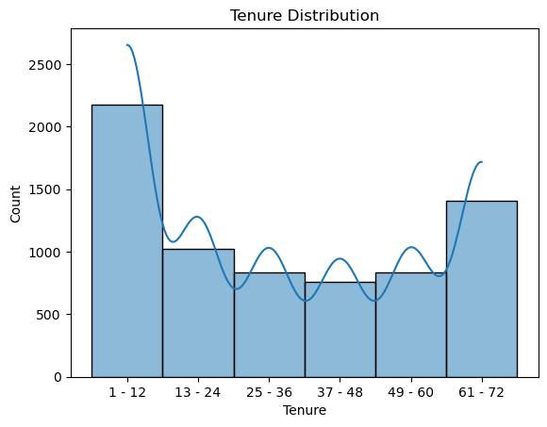
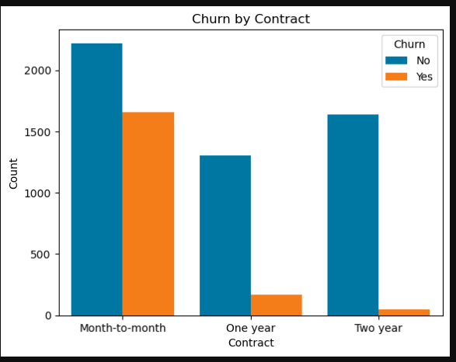
EDA :
The plot shows the distribution of tenure (the length of time a customer has been with the company) for all customers. It helps in understanding the distribution of customer loyalty.
This Graph shows that the Distribution of churned and non-churned customers based on their contract type.

Slide 8
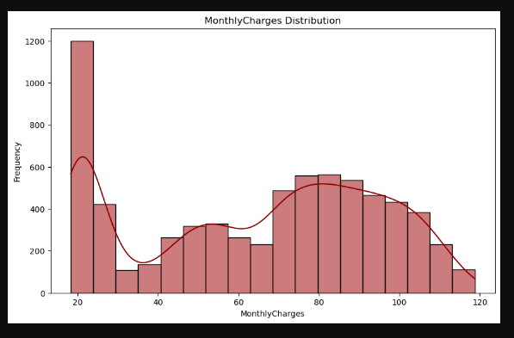
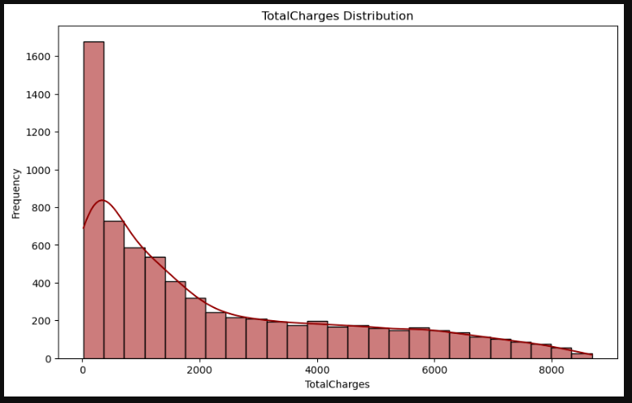
Monthly Charges Distribution:
- The histogram shows the distribution of monthly charges among customers.
- The height of each bar indicates how many customers fall into each range of monthly charges.
- The kde (kernel density estimation) curve overlaid on the histogram provides a smoothed estimate of the distribution of monthly charges.
The height of each bar indicates how many customers fall into each range of total charges.

Slide 9
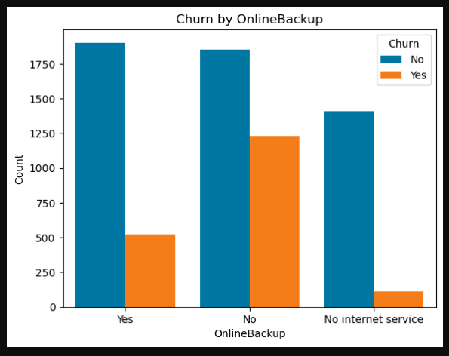
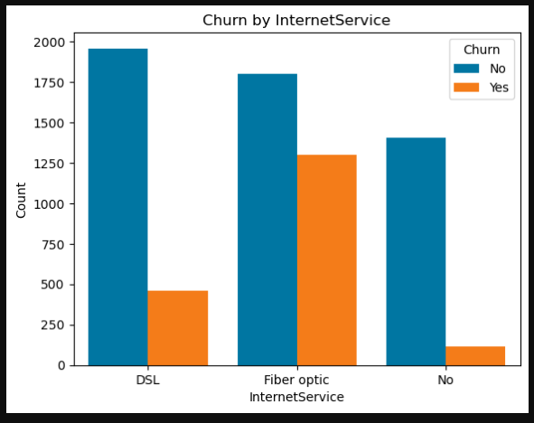
These plot Shows that Customers with fiber optic are more likely to churn compared to those DSL.
This plot shows that the presence or absence of online backup services related to Churn among telecommunication customers.

Slide 10
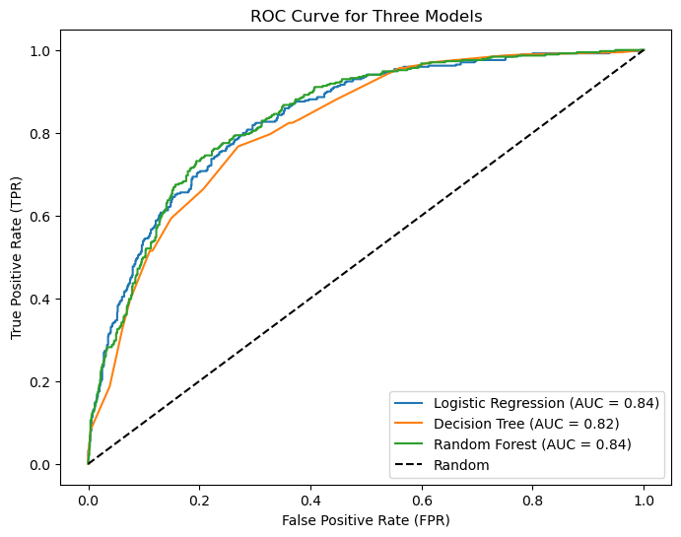
The AUC-ROC curve of the original (imbalanced) data

Slide 11
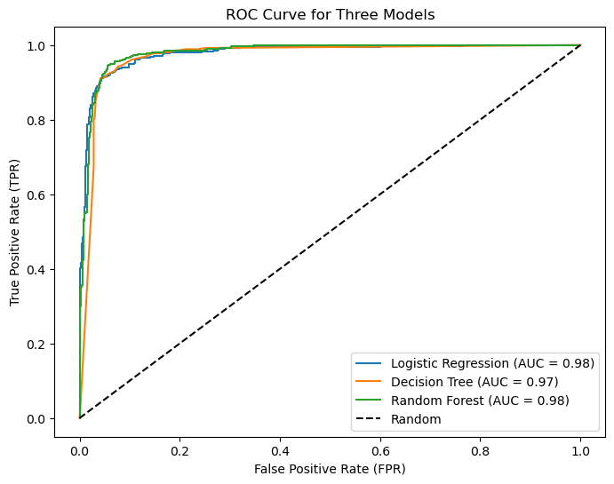
The AUC-ROC curve of the original (balanced) data
Clearly, the balanced data gives more precise and accurate results as compared to the
imbalanced data that we had.

